Slide 1
RiskProfiler.ca
Exploring a better way to share knowledge and empower disaster risk reduction …
Kick-Off Meeting
GSC Offices, 1500-605 Robson St.

Slide 2

Context and Motivation
Anticipated economic losses caused by a catastrophic earthquake in British Columbia or Quebec exceed current risk tolerance thresholds for private sector insurance markets (~$30b) and would likely overwhelm federal emergency backstop measures and existing capacities for recovery at all levels of government. - C.D. Howe Report (C454)

Slide 3
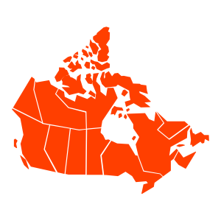
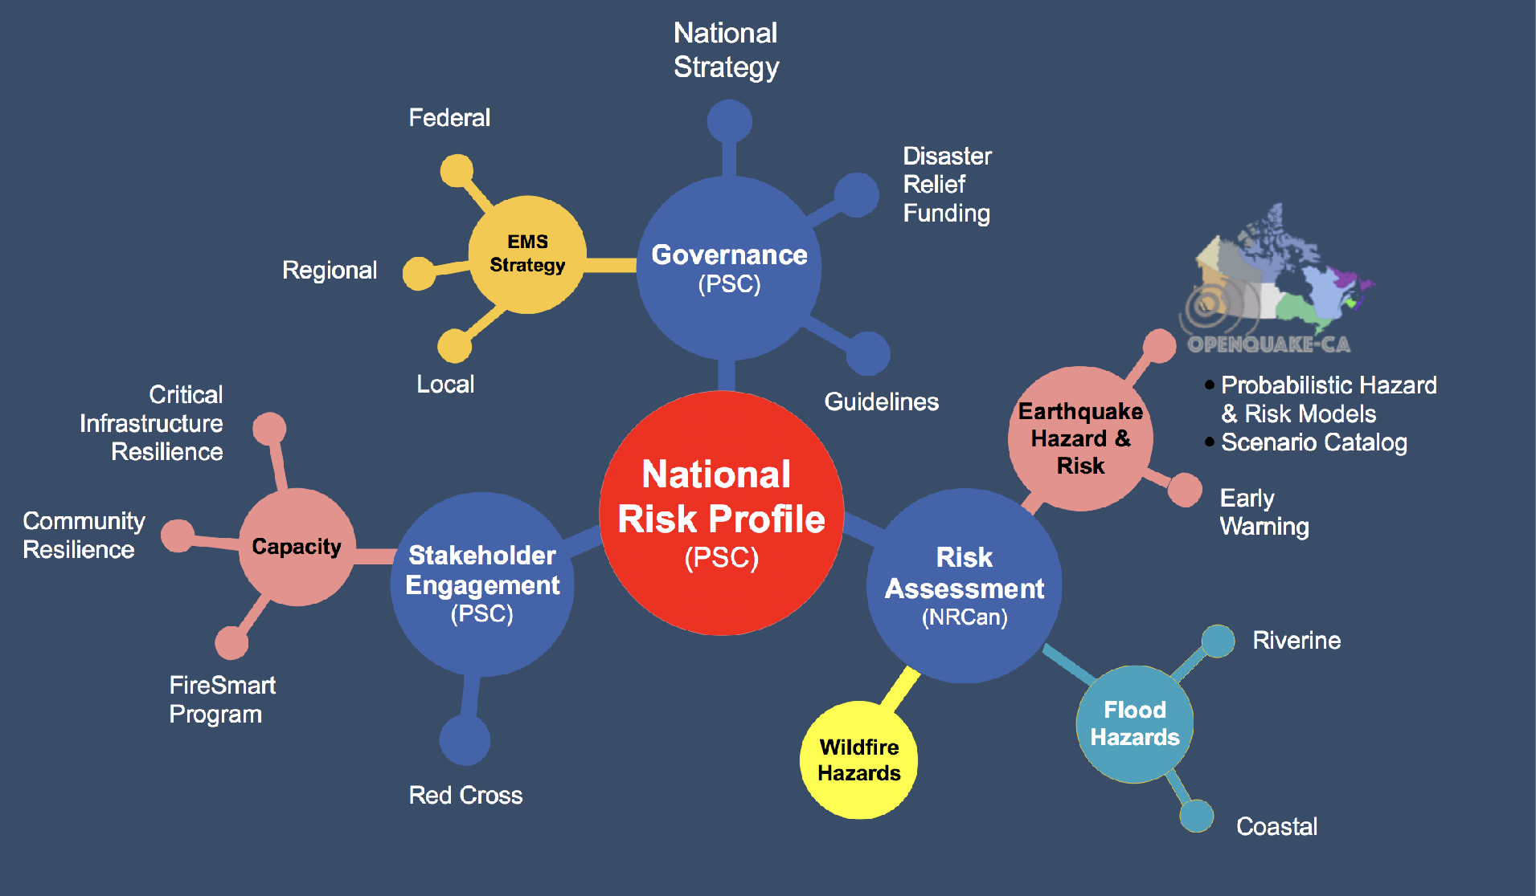
DRR Platform for Canada
Institutional Alignment
Policy Relevance
Evidence-Based
Risk Modelling
Risk Communication
Decision Support
Phase I

Slide 4
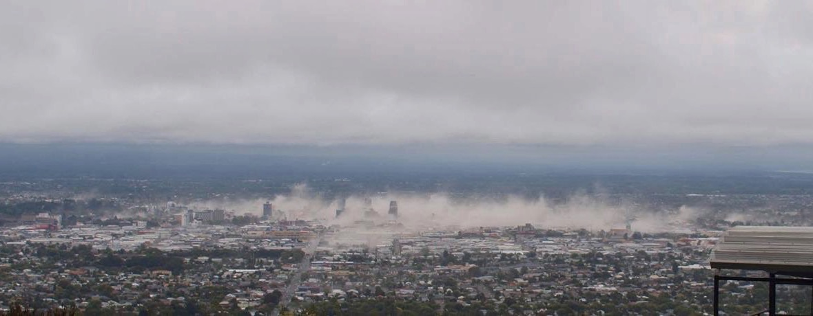
GSC’s Role in Earthquake Risk Assessment
Increase modeling capacity
Develop a public domain seismic risk model to assess the likely impacts & consequences of a major earthquake in Canada
A shared understanding of earthquake risk
Increase understanding of earthquake risk in Canada and capabilities for uptake and use of available evidence to support planning and policy development
Identify opportunities for disaster risk reduction
Establish the necessary base of evidence to inform and evaluate actionable earthquake risk reduction strategies at all scales

Slide 5
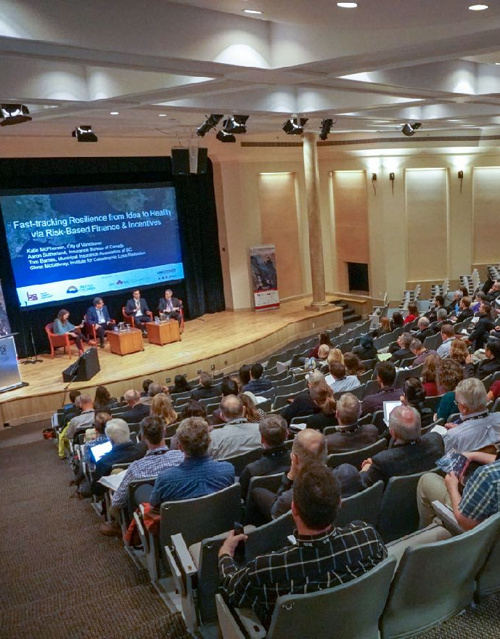




Guiding Principles
Public good
We work to serve the public good: from research to practice, from knowledge to action, our efforts are ultimately motivated by the welfare of the public.
Credible
Co-develop a shared understanding of risk that will both inform and empower risk reduction and disaster recovery planning on the ground in southwest British Columbia
Collaborative
We work with partners across sectors, geographies and disciplines to generate and exchange knowledge that helps inform and support implementation of the Sendai Framework in a Canadian context
Open and transparent
Our methods, tools and outputs are transparent and made accessible to the public through open data, open science and open platform protocols
5

Slide 6
What is new or innovative about this project?
Why should anyone care?

Slide 7
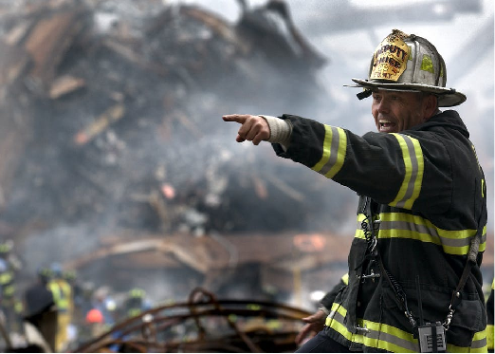
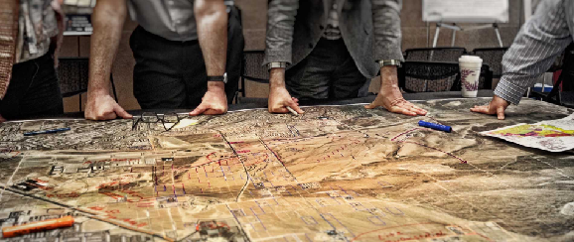


1st Generation Earthquake Risk Model for Canada
Emergency Management
Land Use Planning
Financial Planning

Slide 8
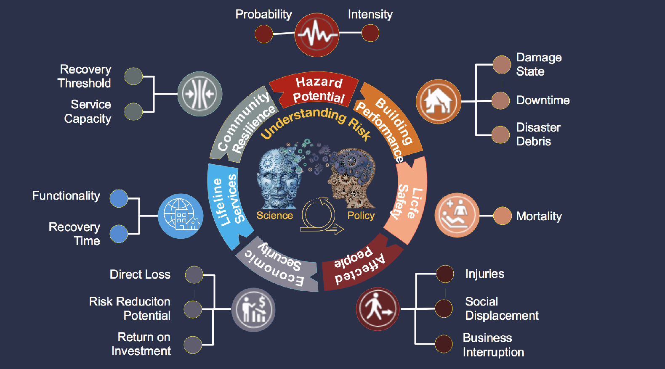
Understanding Patterns of Earthquake Risk

Slide 9
What can we expect from a damaging earthquake in Canada?

Slide 10
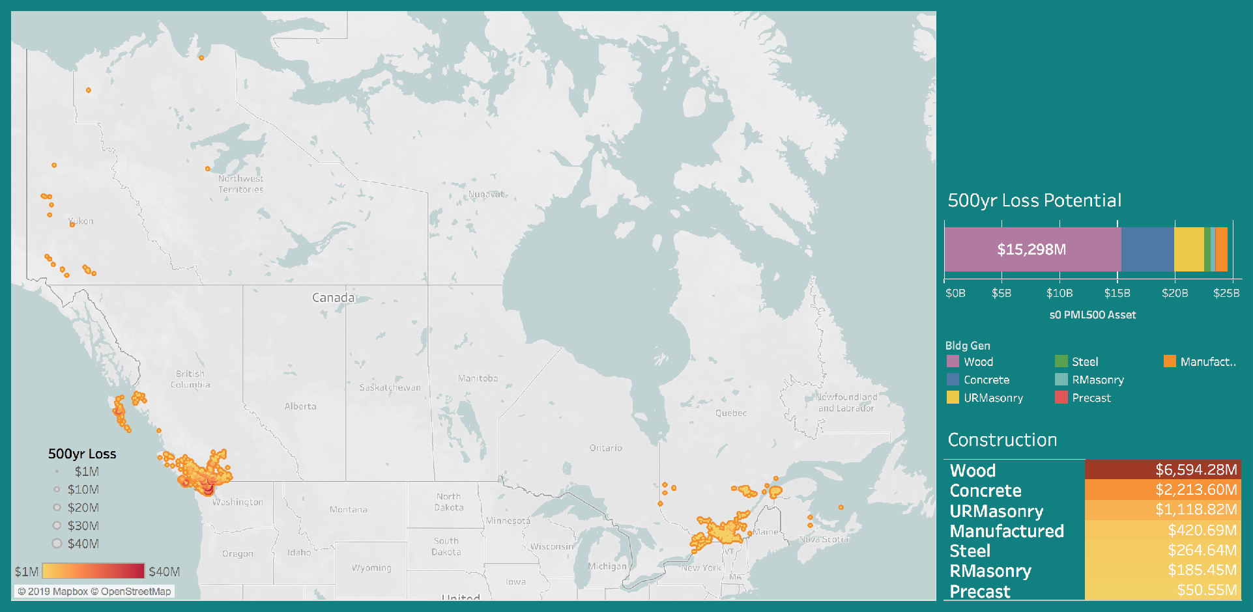
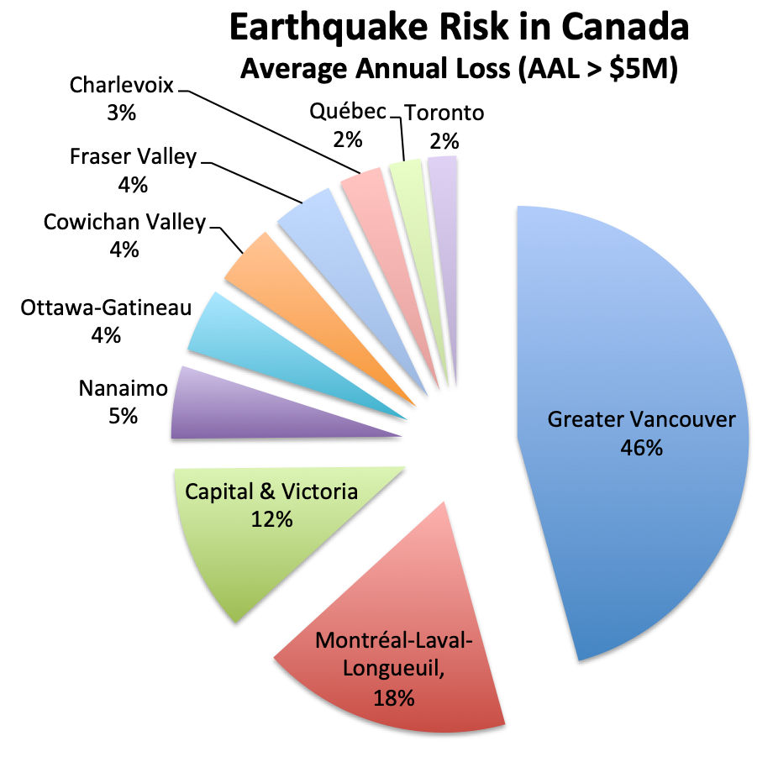

Earthquake Risk Model - Economic Security
Economic Security
1/500 yr Loss
~$20B
~$5B

Slide 11
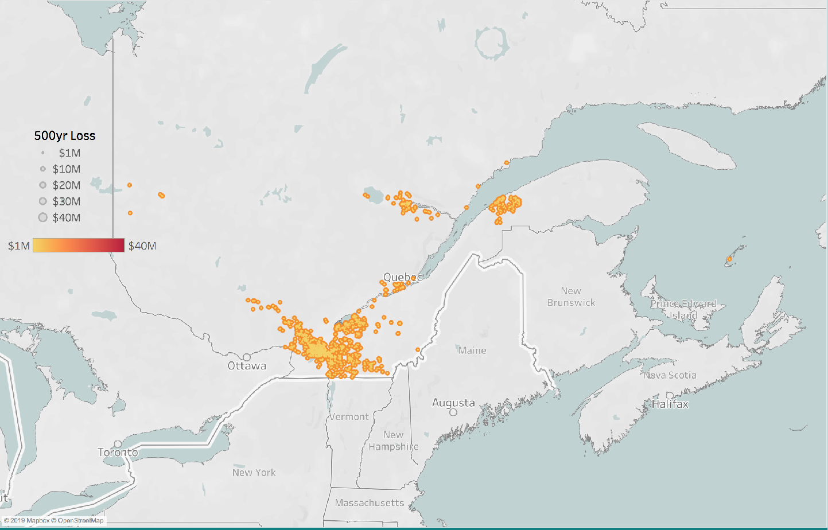
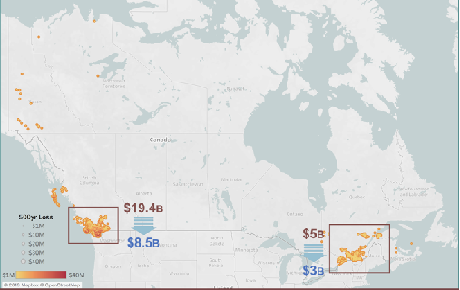
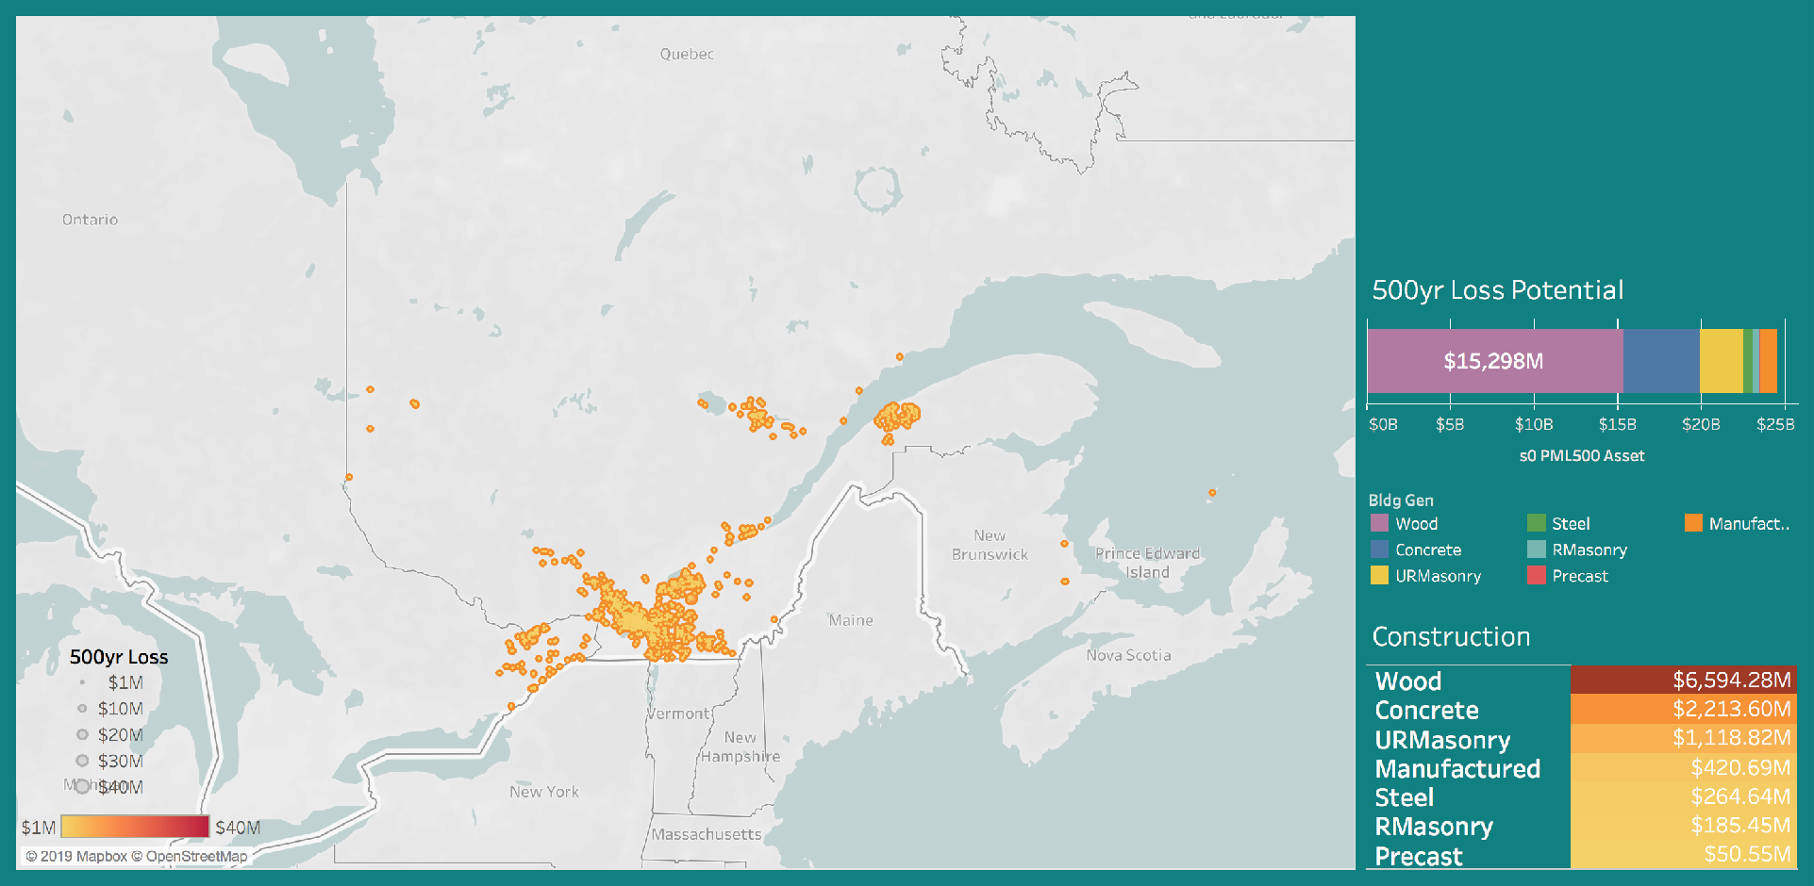
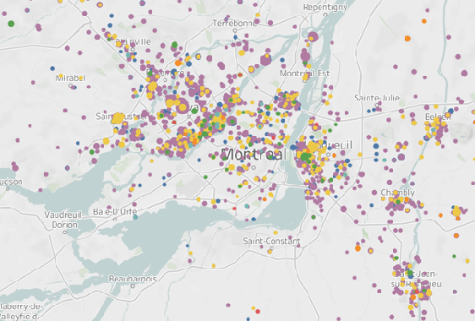
Earthquake Risk Model - Economic Security
Economic Security
1/500 yr Loss
~$5B
Quebec
Montreal
Montreal
Ottawa
Montreal
> $150,000

Slide 12
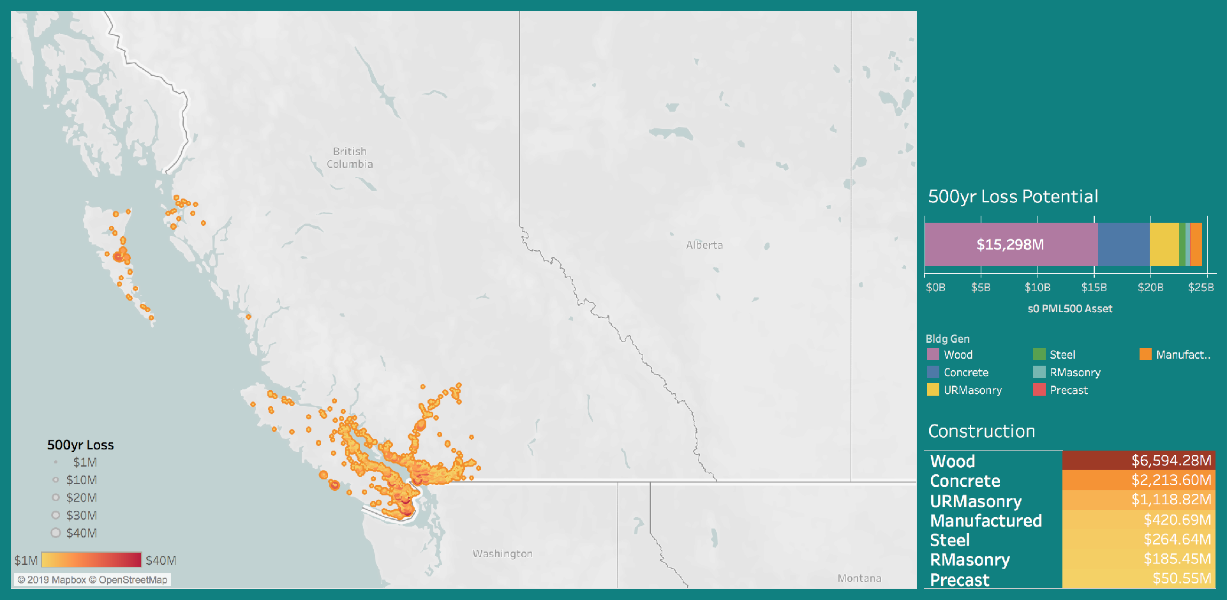
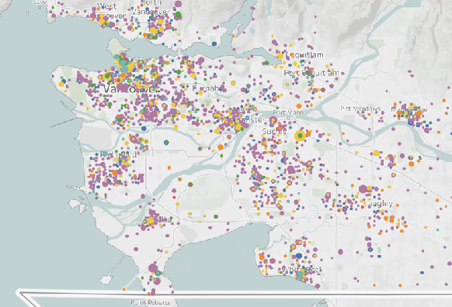
Earthquake Risk Model - Economic Security
Economic Security
1/500 yr Loss
~$20B
Vancouver
Vancouver
Victoria
> $500,000

Slide 13
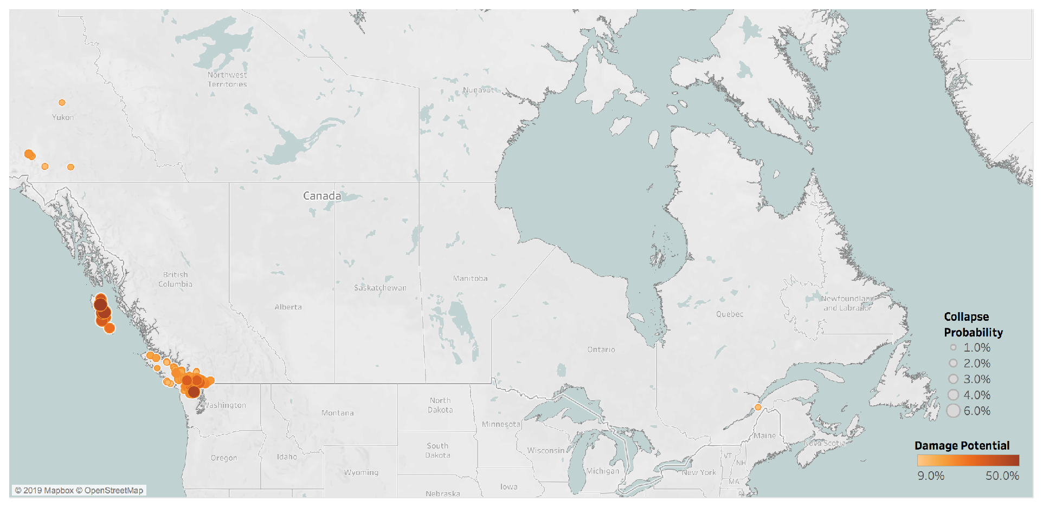
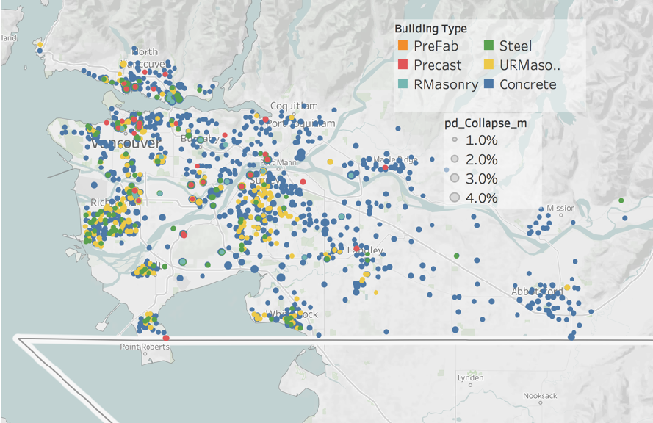
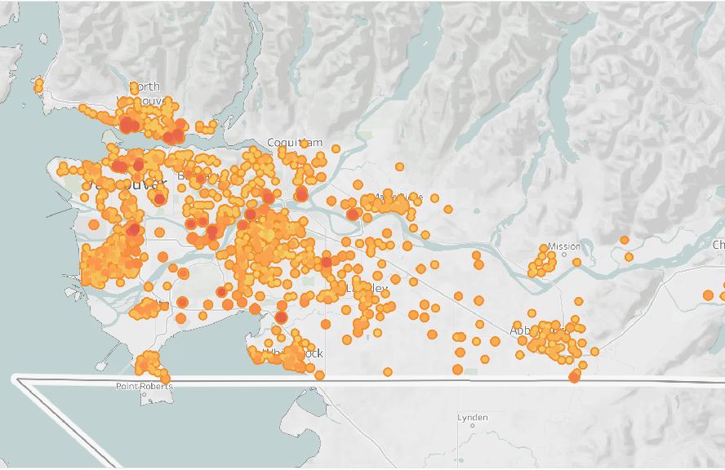
Earthquake Risk Model - Building Performance
Collapse Potential
1%/50 yr
Vancouver
Vancouver
Victoria

Slide 14

How resistant is the built environment?

Slide 15

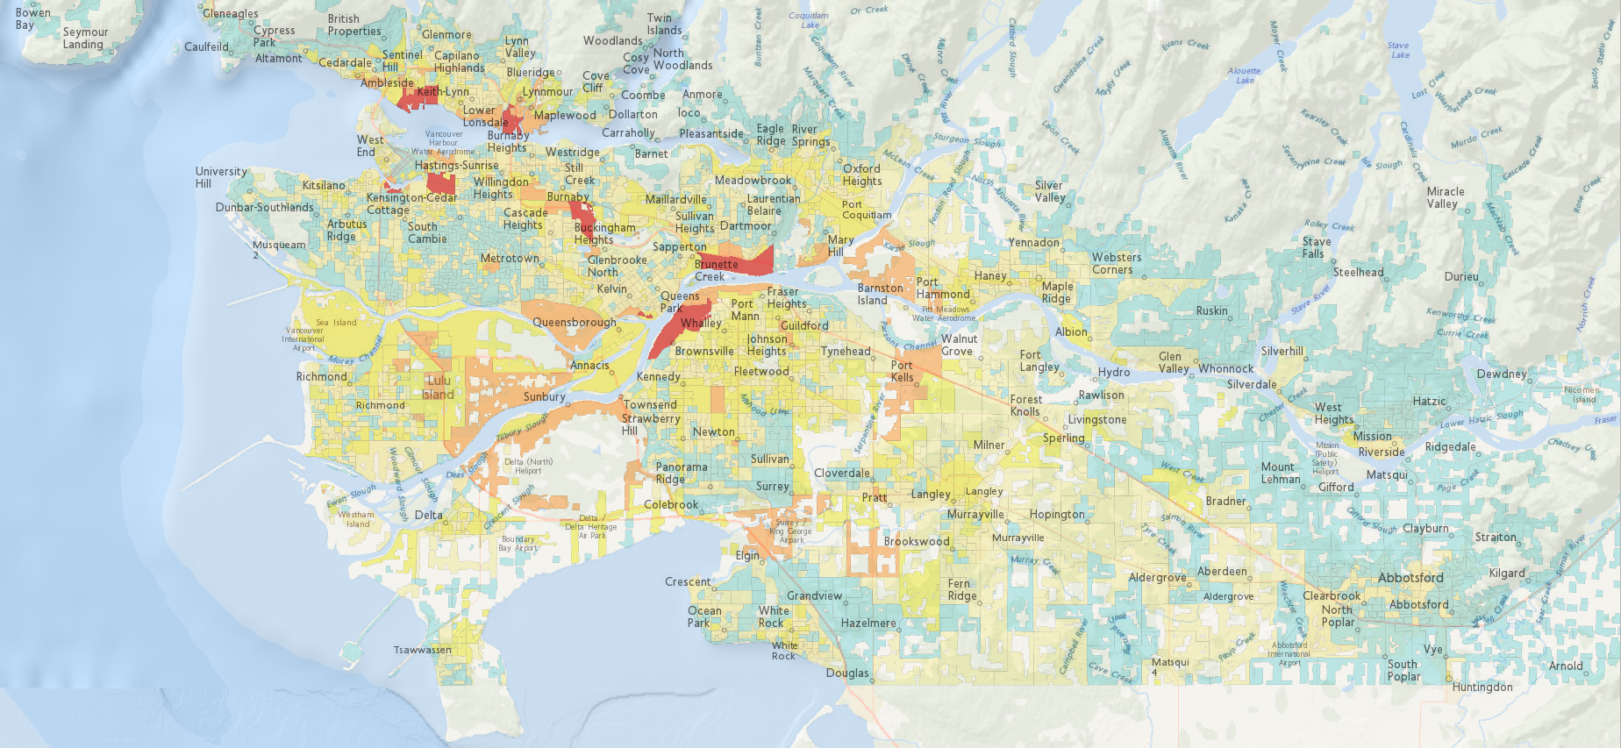
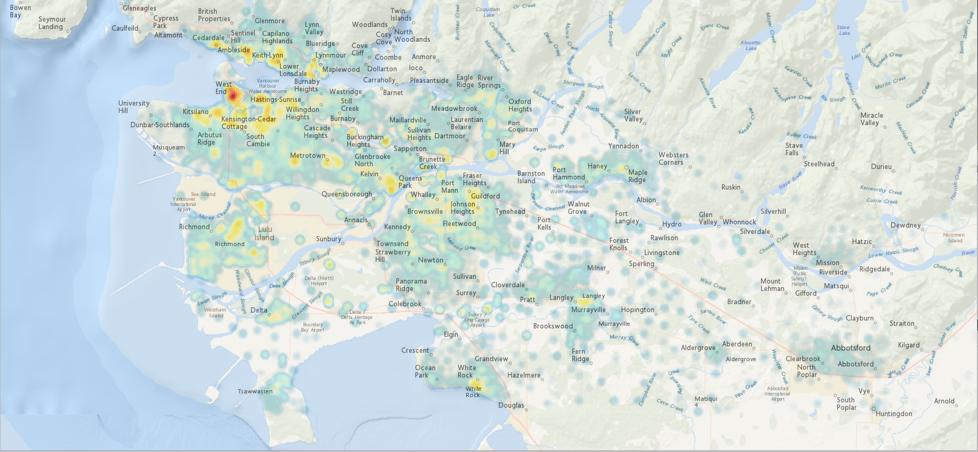
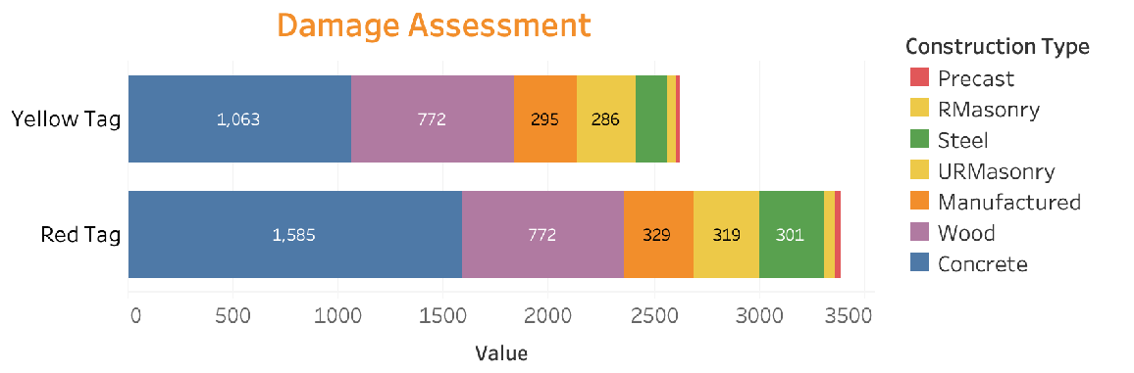
Building Performance
Ground shaking
Building Damage
Proportion of Red Tag Buildings

Slide 16
What are the implications for public safety?

Slide 17

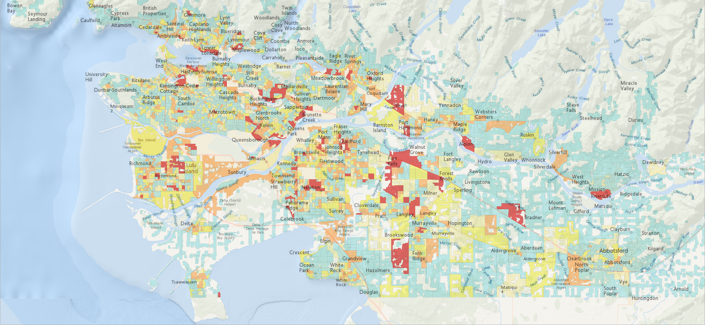
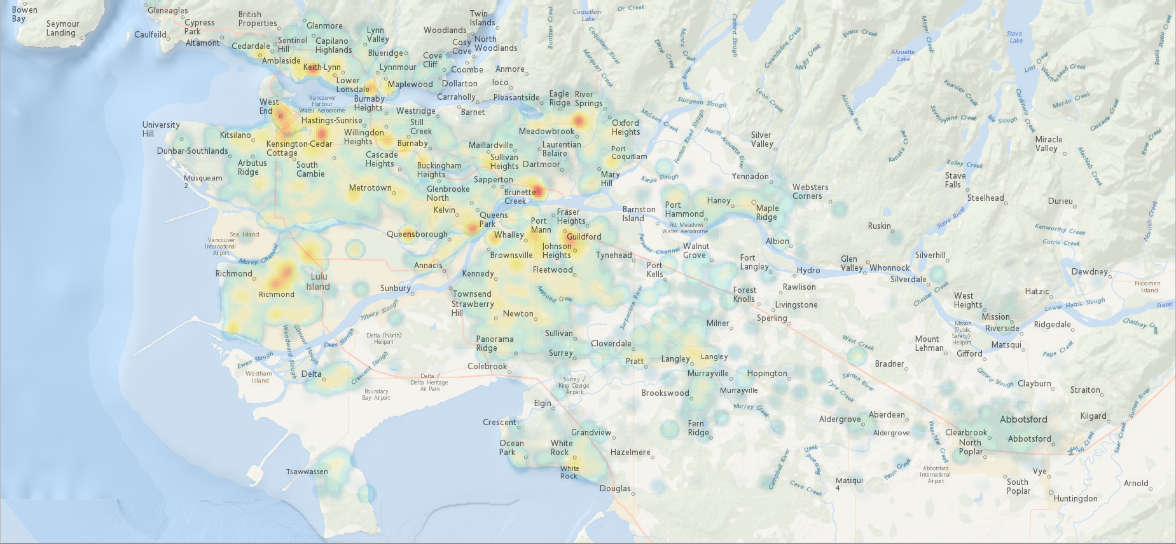
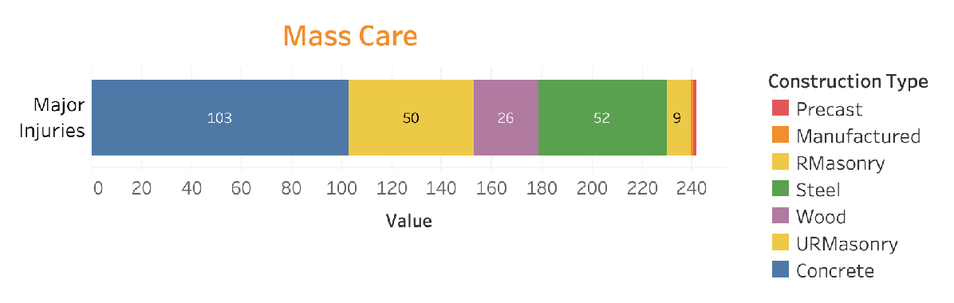
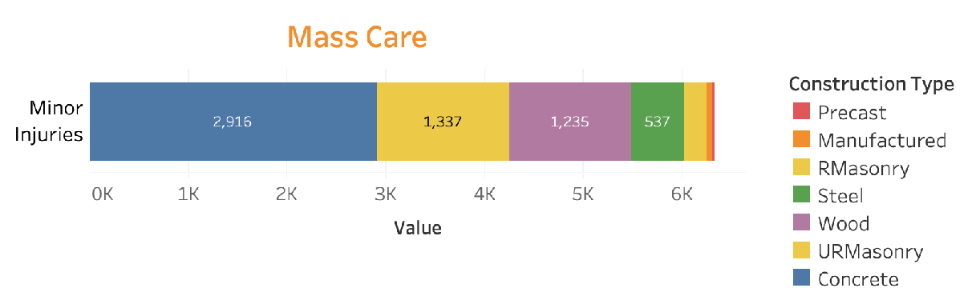
Public Safety
Ground shaking
Public Safety
Major Injuries

Slide 18
Who is most vulnerable to earthquake impacts?

Slide 19

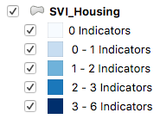
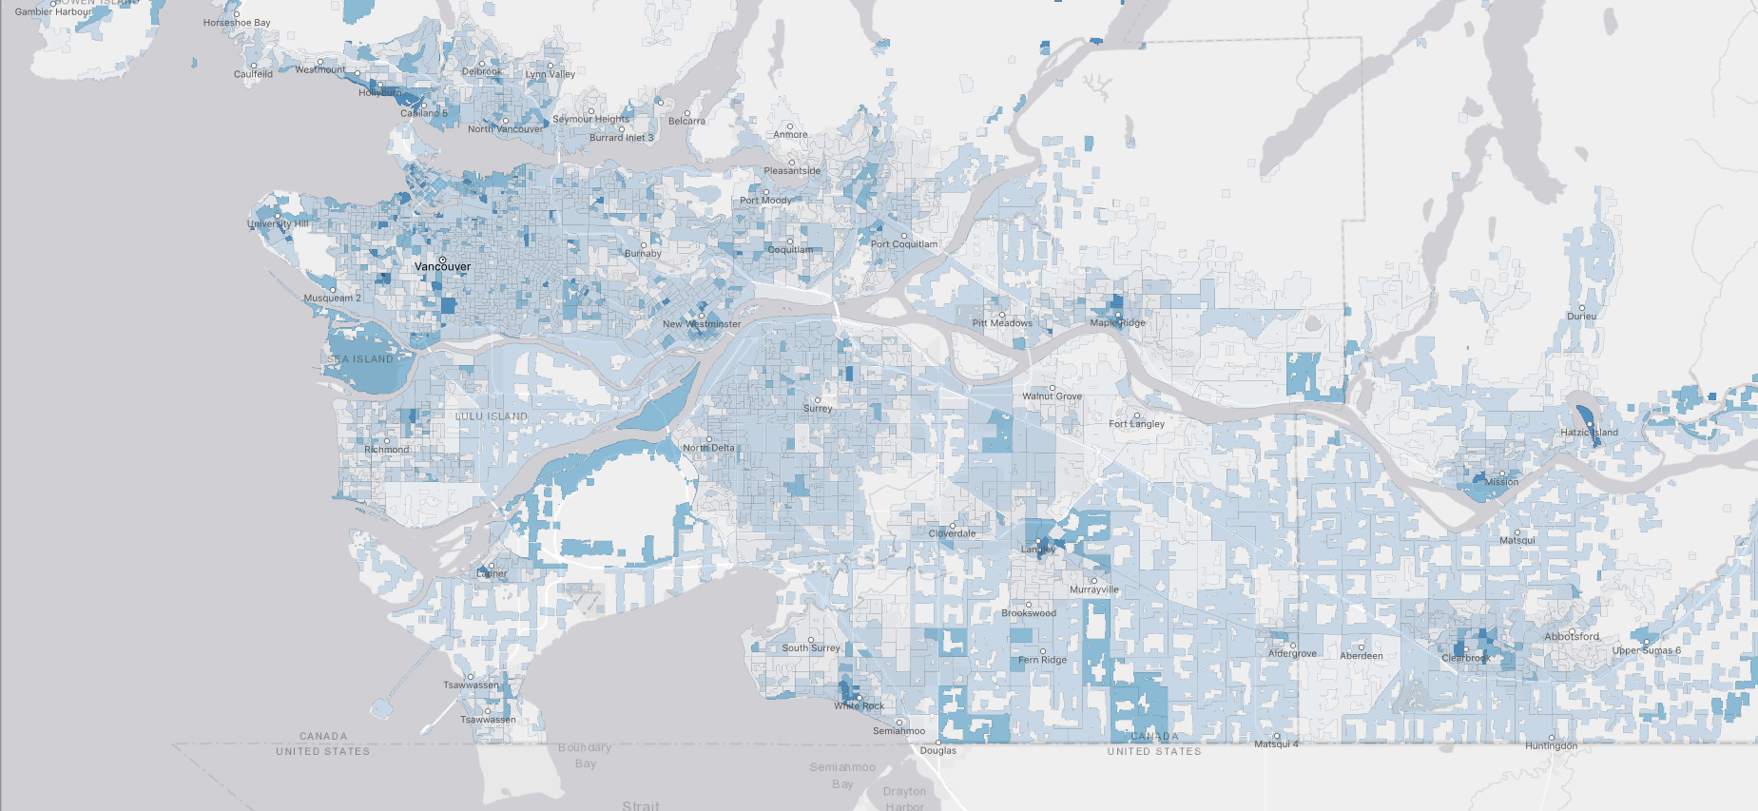
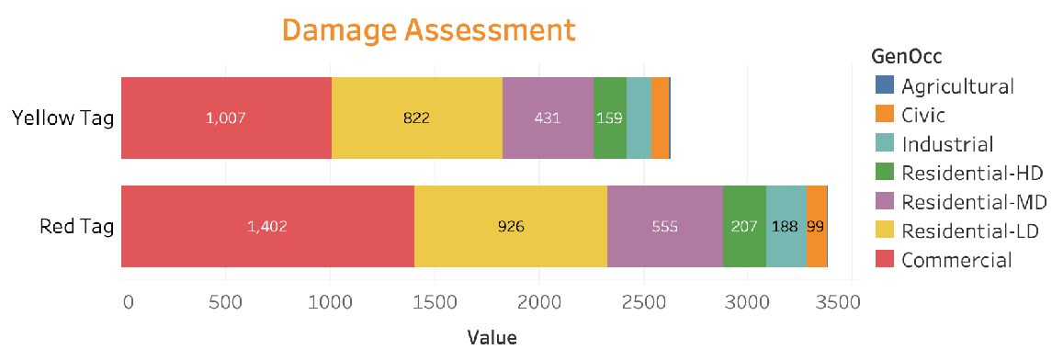
Affected People - housing conditions

Slide 20
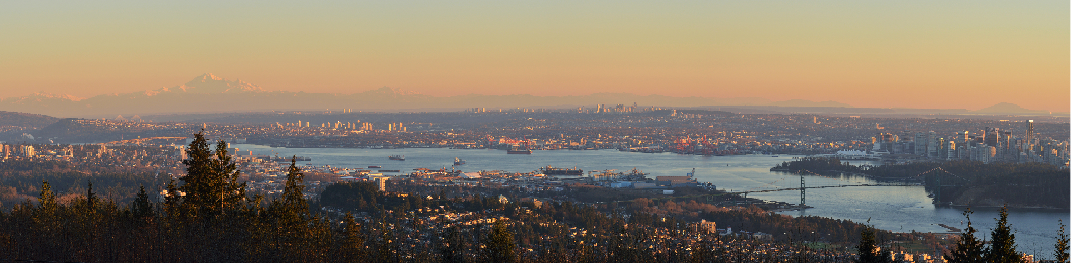

Which natural hazards are of greatest concern in my neighbourhood?
Who and what are most vulnerable to the impacts of known hazard threats?
What are the likely impacts and consequences of a major earthquake disaster in Canada?
How can we reduce the risk and ensure our capacity to respond and recover from future disasters events?

Slide 21
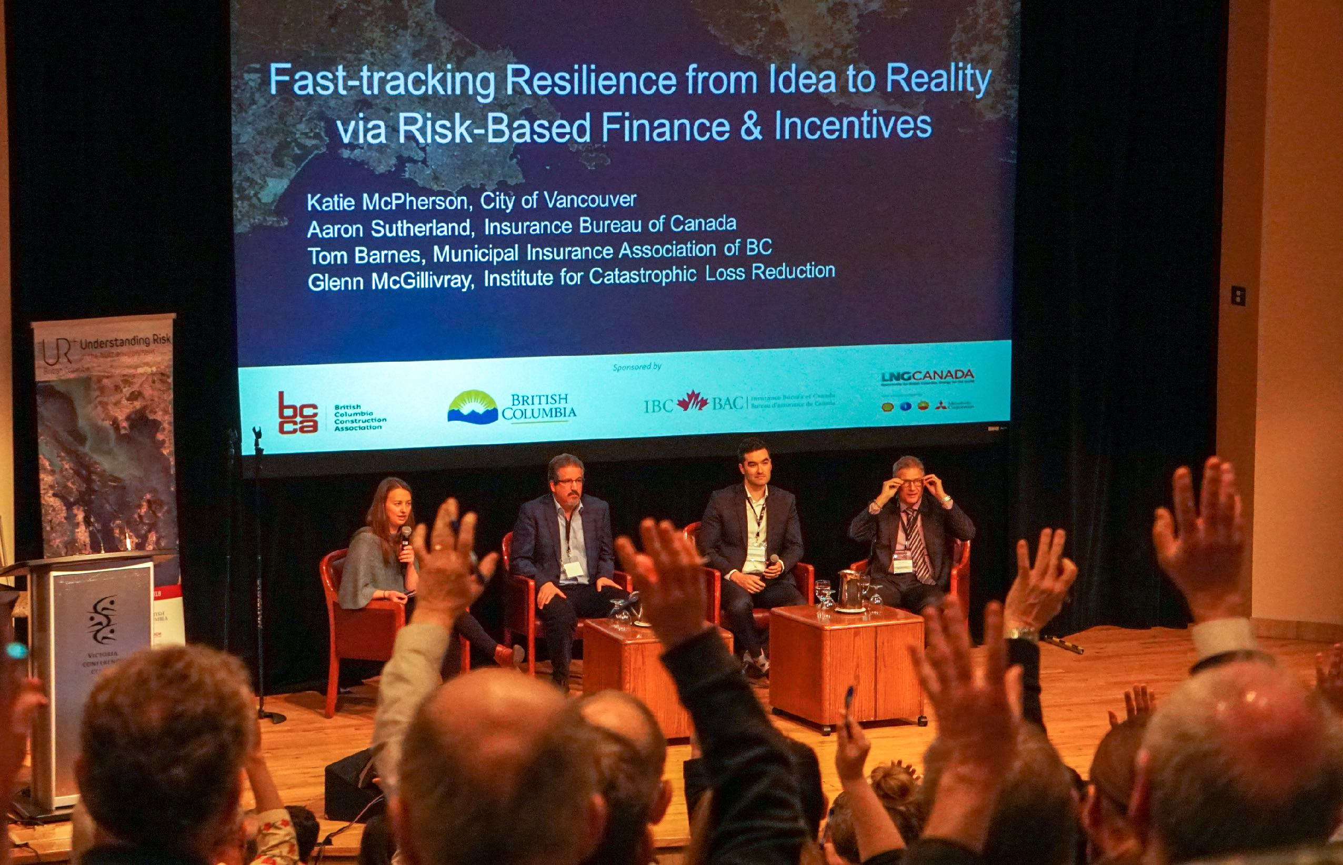






+
Understanding
Risk
Emergency Management
Community Planning
Bridging the gap between knowledge and action
+
+
+
+
+
=
Public
Safety
Economic
Security
Building Performance
Recovery
Time
Lifeline Services
Social
Disruption
Disaster Resilience
Financial Planning

Slide 22
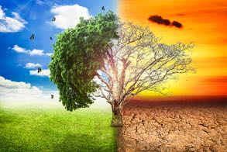
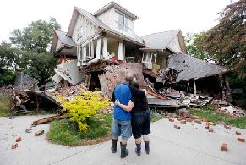
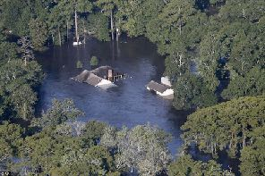
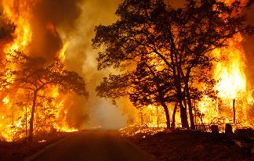
Who are the primary audiences?
Climate Change
Earthquake
Flood
Risk
Fire
Actors
Type of
Participation
Dominant Risk Characteristic
Time Horizon
adapted from Renn & Klinke, 2004

Slide 23
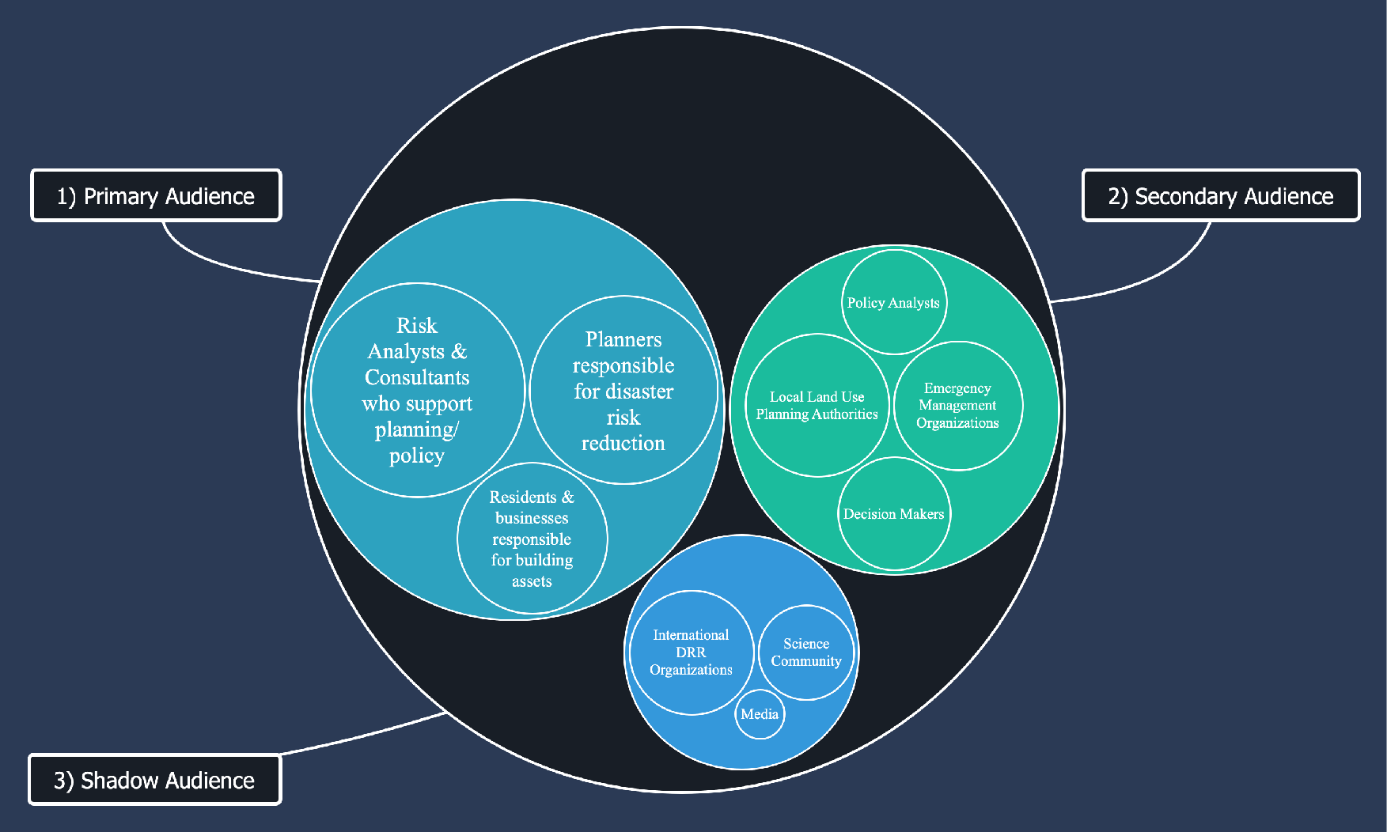

Slide 24
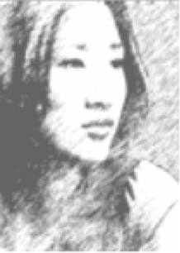
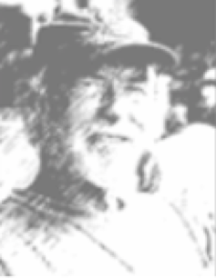


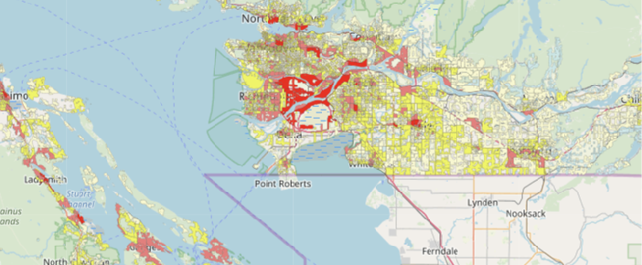
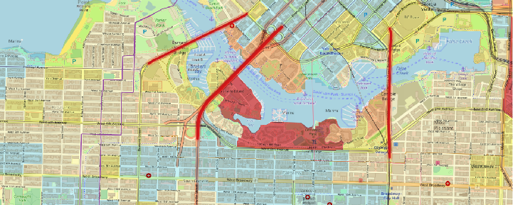

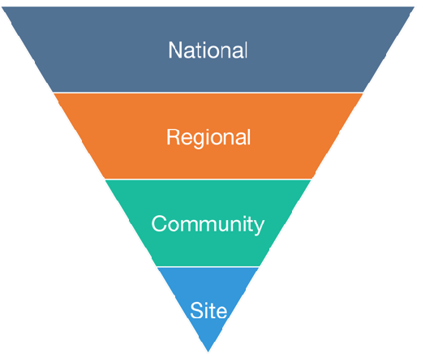
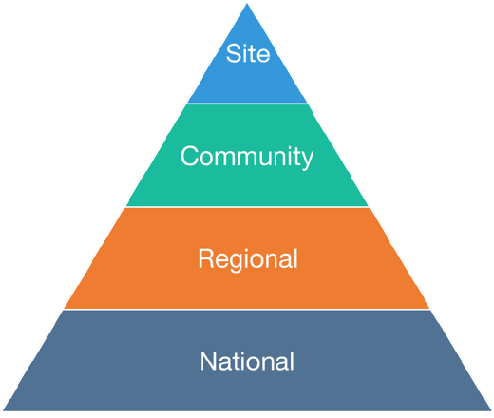
Planner
Risk Analyst
Resident
Business Owner
Context
Focus
Focus
Context

Slide 25
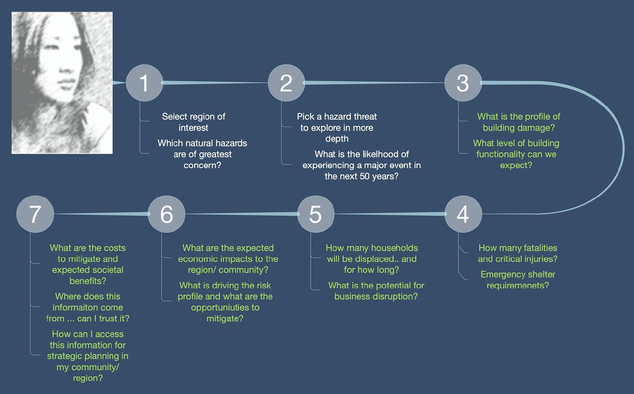
Planner

Slide 26
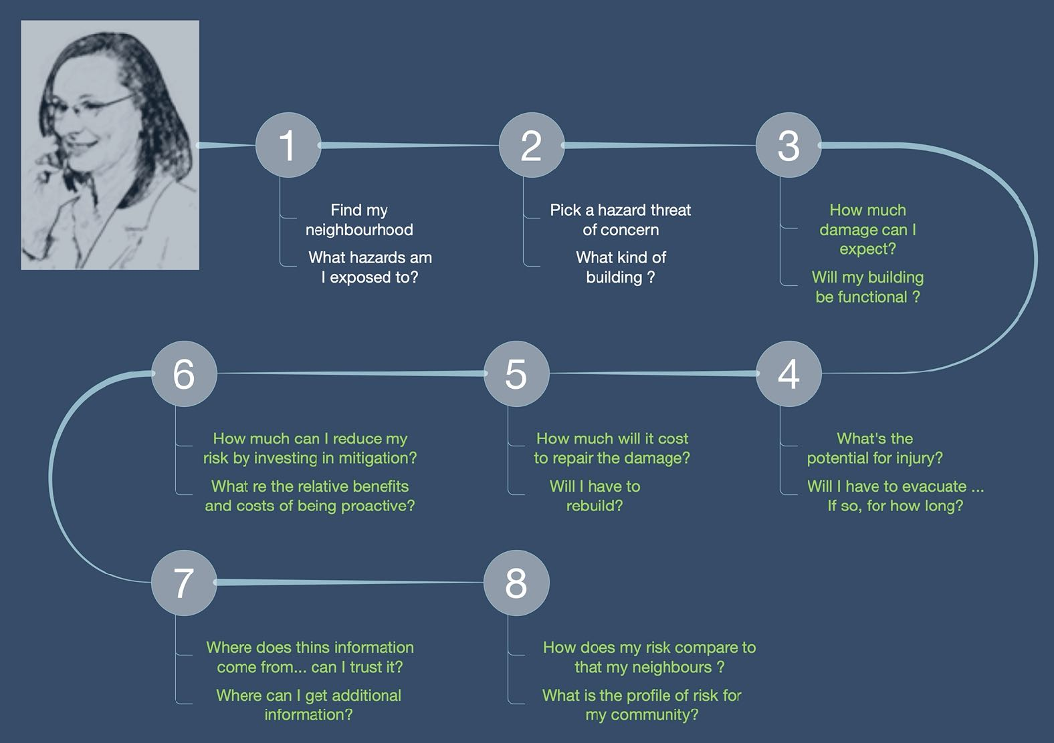
Resident/Business

Slide 27






RiskProfiler.ca

Slide 28
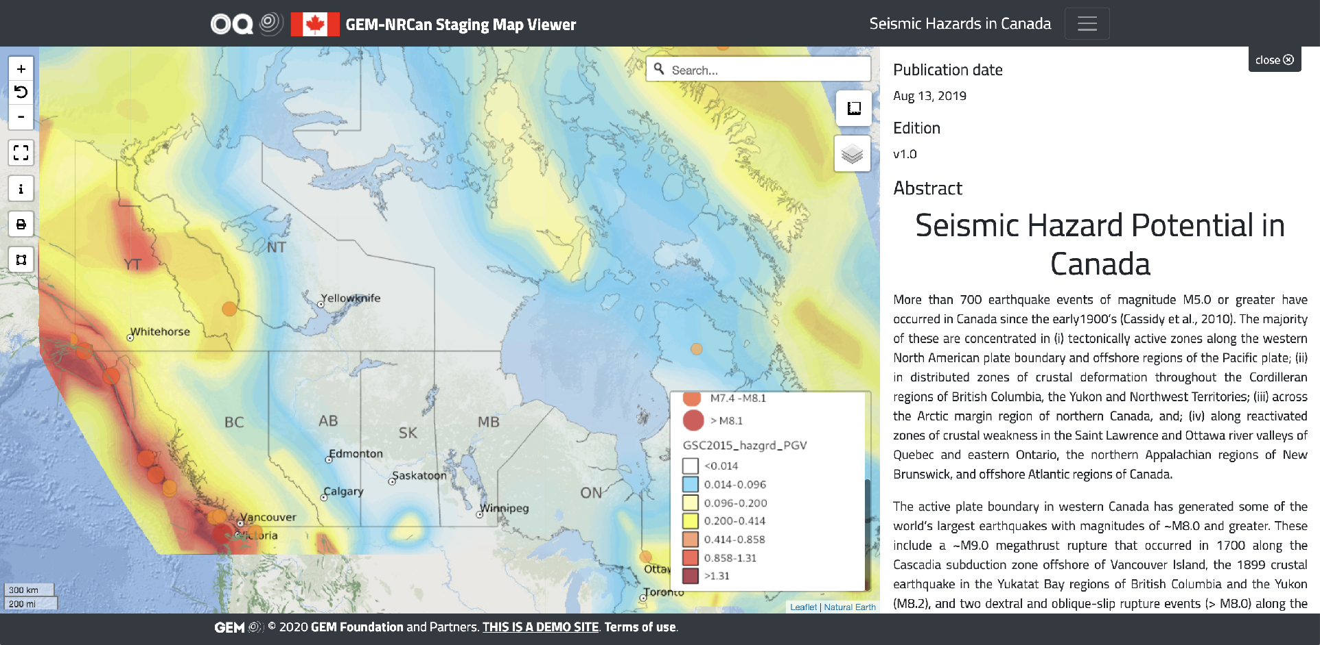
OpenQuake-Canada (web mapping site for technical audience(s)

Slide 29
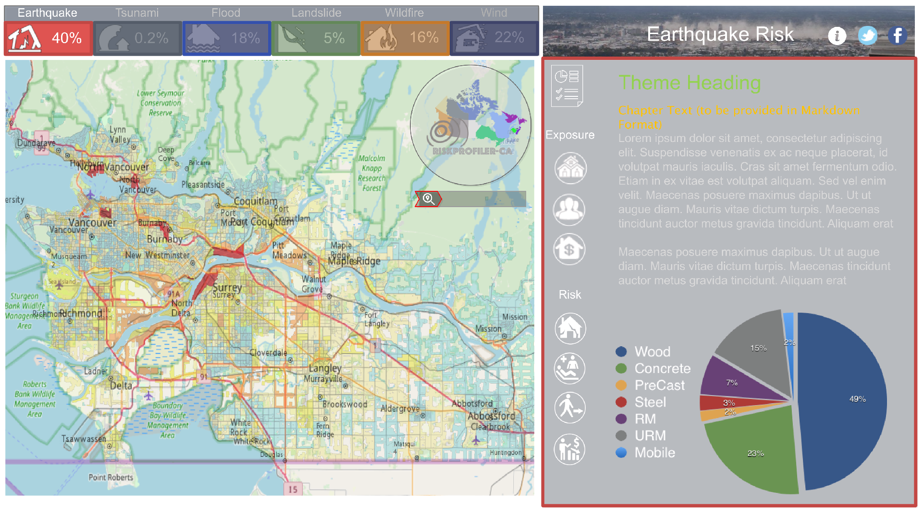
RiskProfiler.ca story mapping site for planners & public audience(s)

Slide 30
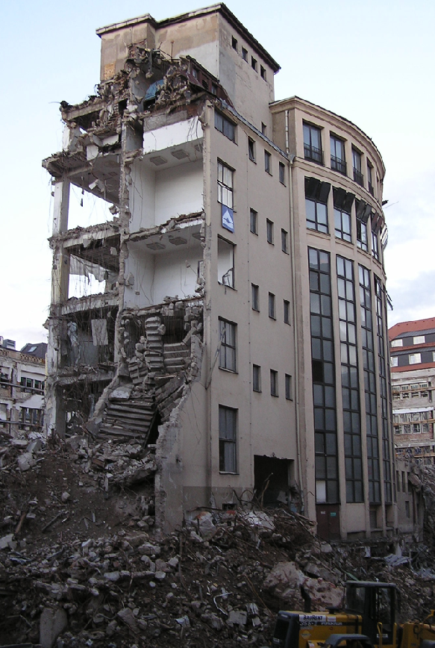
Key Messages
Anticipated losses from a catastrophic earthquake in Canada are likely to exceed the cumulative effects of all recorded disaster events over the past 200 years.
The direct physical impacts and cascading socioeconomic consequences of a major earthquake in Cascadia will strain existing capabilities for response and recovery at all levels of society
Our profile of risk is expected to increase significantly in hotspot regions as a result of changes in the 2020 national seismic hazard assessment
Evidence supports a very strong business case for pre-event emergency response and recovery planning — and proactive investments in mitigation of our most vulnerable buildings and infrastructure

Slide 31
What is the State of Play?

Slide 32
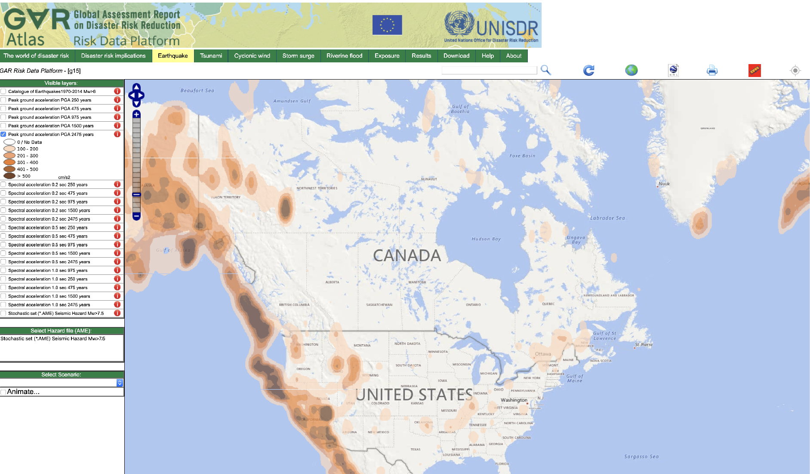
https://risk.preventionweb.net/capraviewer/main.jsp?tab=2&mapcenter=-6006675.6750157,7070959.4351314&mapzoom=4

Slide 33
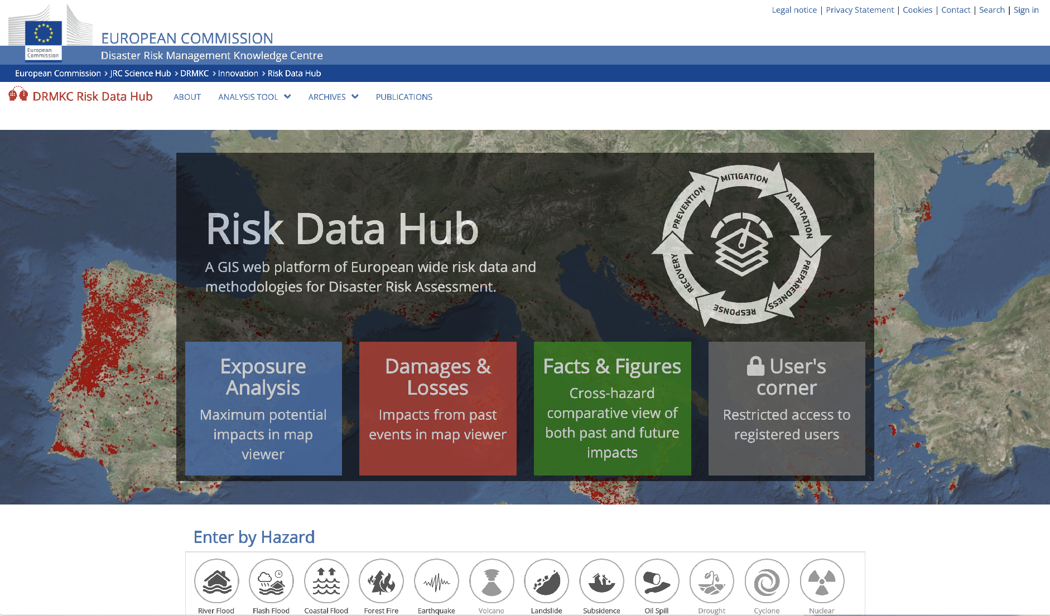
https://drmkc.jrc.ec.europa.eu/risk-data-hub

Slide 34
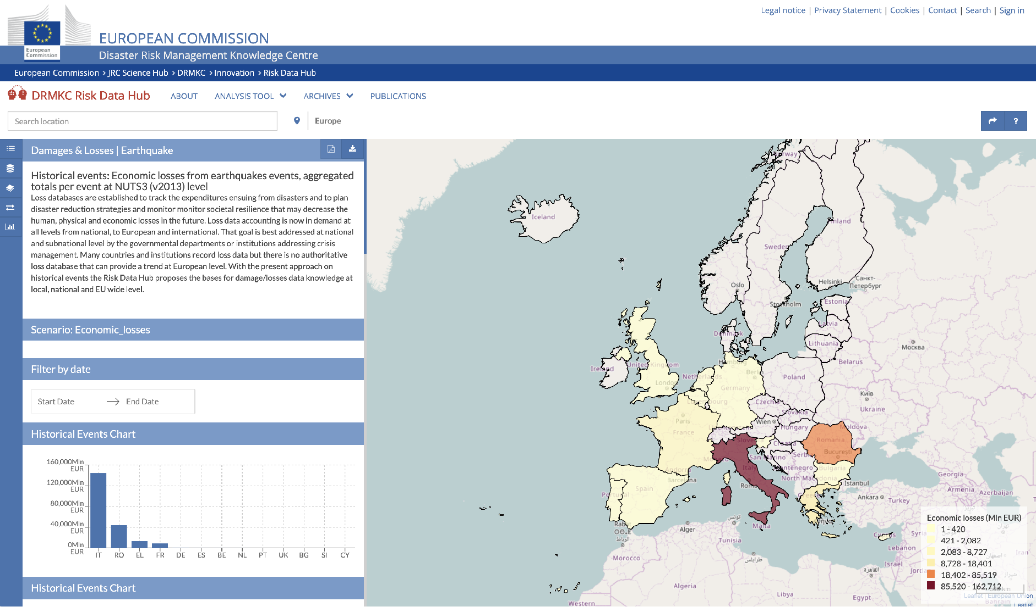
https://drmkc.jrc.ec.europa.eu/risk-data-hub

Slide 35
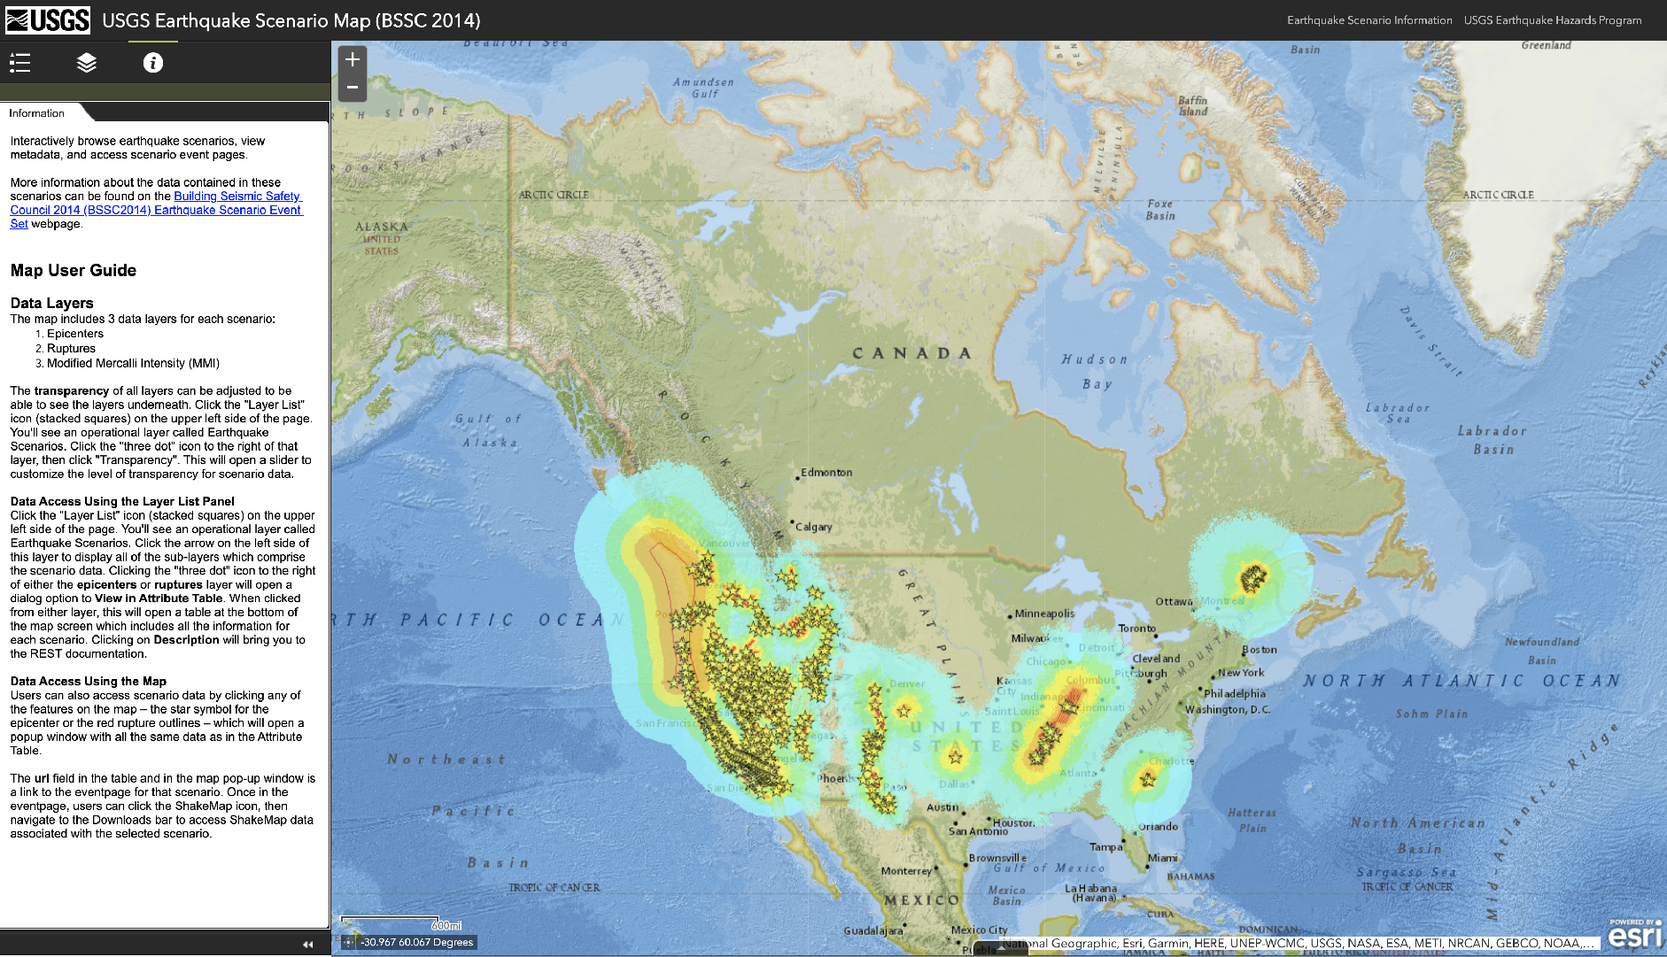
https://usgs.maps.arcgis.com/apps/webappviewer/index.html?id=14d2f75c7c4f4619936dac0d14e1e468

Slide 36

http://seattlecitygis.maps.arcgis.com/apps/MapSeries/index.html?appid=0489a95dad4e42148dbef571076f9b5b

Slide 37

http://seattlecitygis.maps.arcgis.com/apps/MapSeries/index.html?appid=0489a95dad4e42148dbef571076f9b5b

Slide 38

http://seattlecitygis.maps.arcgis.com/apps/MapSeries/index.html?appid=0489a95dad4e42148dbef571076f9b5b

Slide 39

http://seattlecitygis.maps.arcgis.com/apps/MapSeries/index.html?appid=0489a95dad4e42148dbef571076f9b5b

Slide 40

https://maps.calgary.ca/DisasterRiskExplorer/

Slide 41

https://maps.calgary.ca/DisasterRiskExplorer/

Slide 42

https://maps.calgary.ca/DisasterRiskExplorer/

Slide 43

Questions ?
murray.journeay@canada.ca
phone: 604-666-1130

